Slide 1
PHP PR294
Live Chat
ISAAC MACKLE

Slide 2
website demonstration
Live Chat

Slide 3
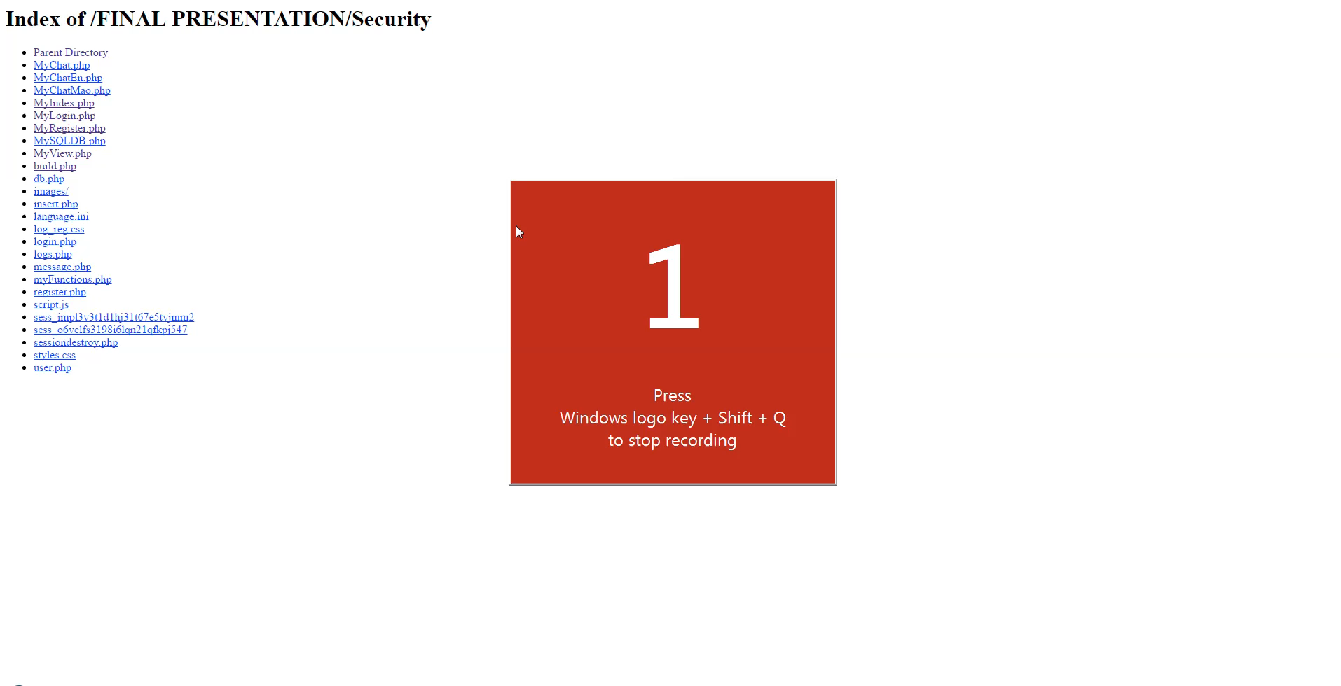
Live Chat Demonstration Video

Slide 4
Must have Features
Behat Scenarios

Slide 5
Behat Feature #1
Feature #1: Display message using REST web service
In order to send messages over the internet As a User I need to be able to input a message and have it displayed on the target web page.
Scenario: I want to send a message to a web page from a REST web service Given that the REST web service is setup When I type a message into the REST web service Then the message is sent to the web page.

Slide 6
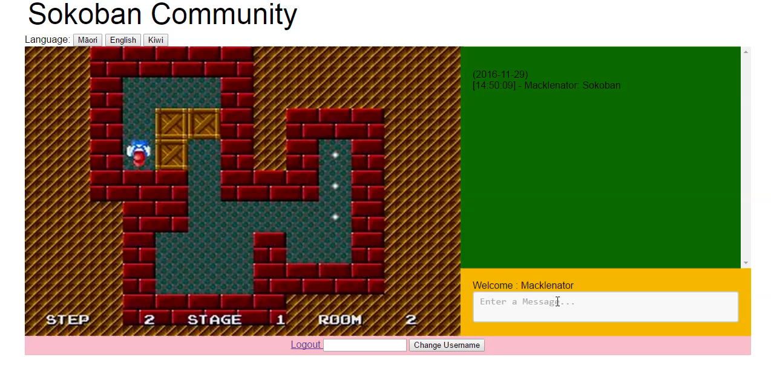
Behat Feature #1 – Demo Video

Slide 7
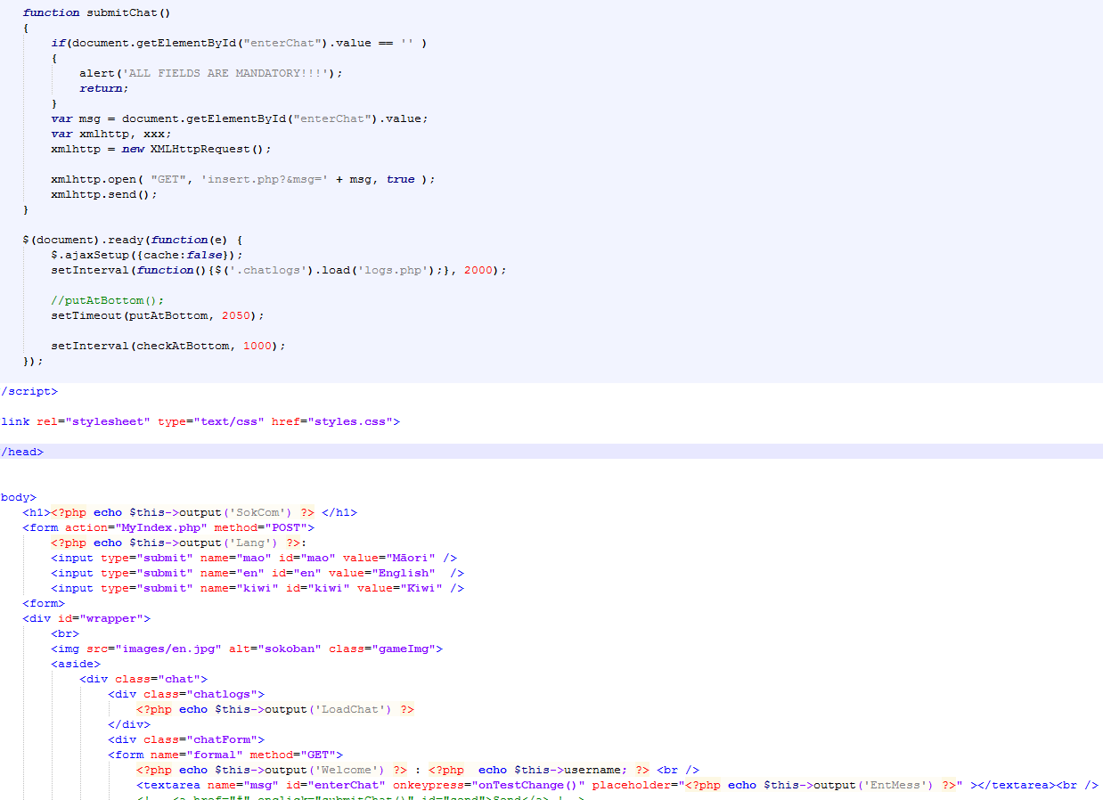
Behat Feature #1 – Scenario 1 Code
The message is grabbed from the ‘textarea box’ and is then sent to ‘insert.php’ with ajax where the ‘message’ is inserted into the database ready to be displayed.
script.js
MyChatEn.php

Slide 8
Behat Feature #2
Feature #2: Store messages in DB In order to store messages in a centralised location As a User I need to be able to have the messages I send to a web page stored inside a database.
Scenario: When a message is sent to the web page is it then stored in the database. Given that a database exists When a message is sent to the web page Then it is stored in the database
Scenario: Retrieving a message from the database Given that a database exists And a message has been stored in the database When the database is queried to show the stored messages Then the messages are displayed.

Slide 9
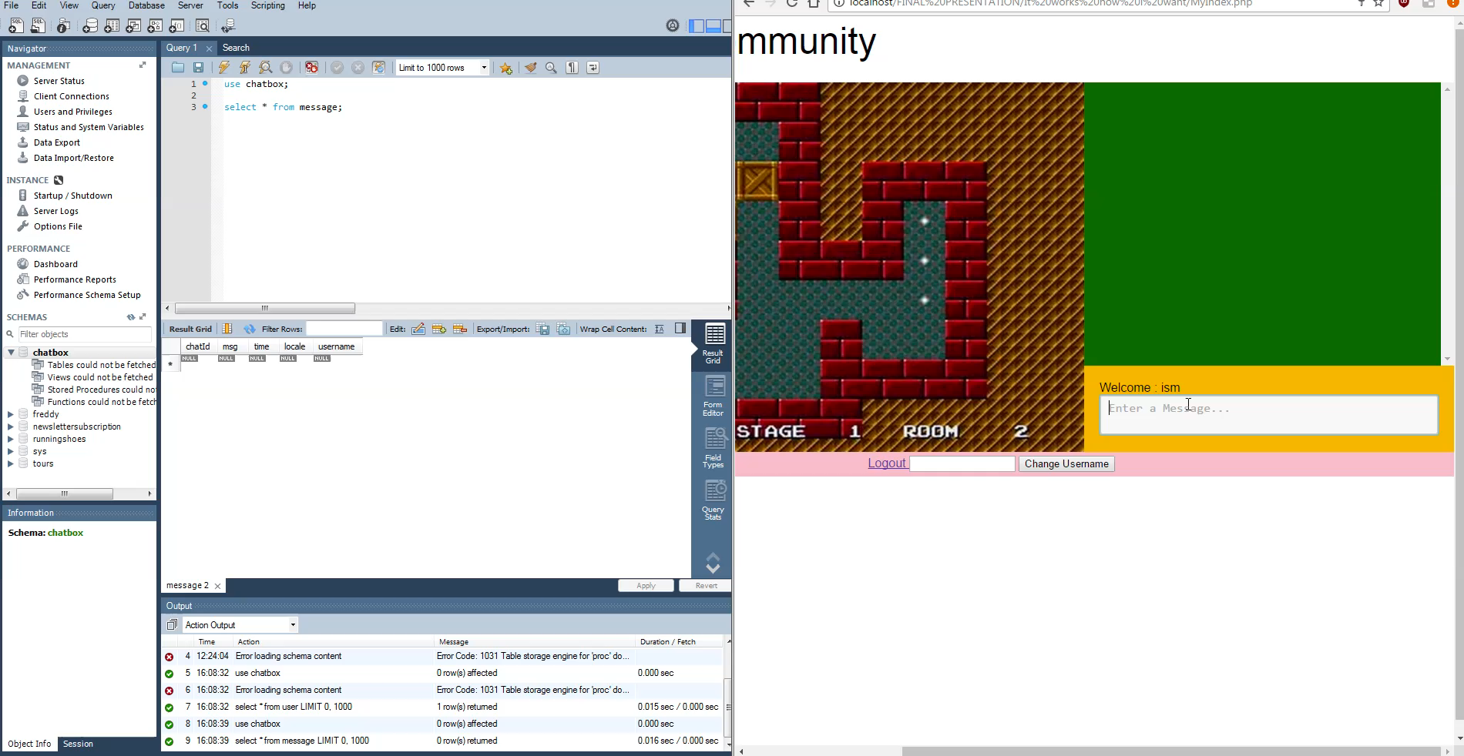
Behat Feature #2 – Demo Video

Slide 10
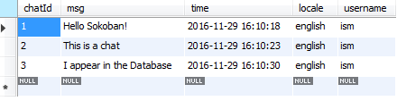
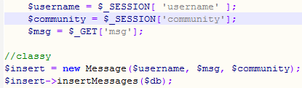
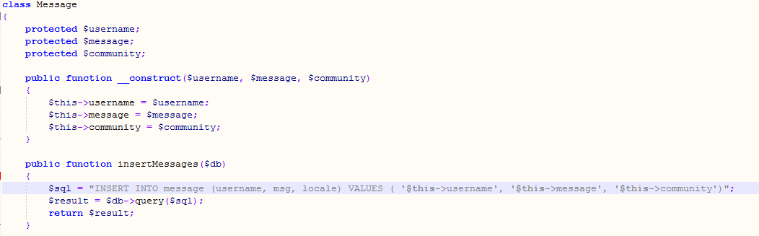
Behat Feature #2 – Scenario 1 Code
insert.php
The ‘message’ is stored in the database along with the ‘username’ and the ‘community’ that the ‘message’ was inputted in to.
message.php
This references ‘MySQLDB.php’ that was provided in class

Slide 11
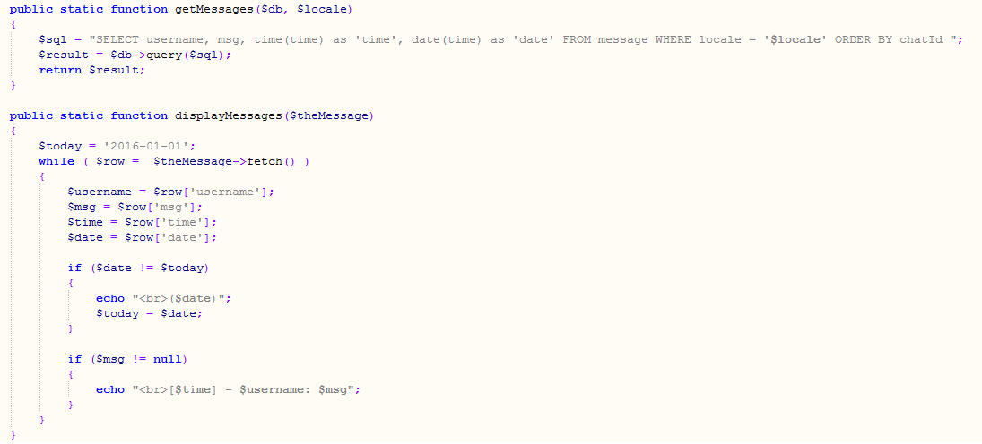
Behat Feature #2 – Scenario 2 Code
The ‘messages’ are retrieved from the database along with the ‘username’ and ‘time’, the ‘date’ is only displayed if it is a new day. The messages are grabbed based on what ‘community’ the user is currently in.
insert.php
message.php

Slide 12
Behat Feature #3
Feature #3: Live updating chat In order to chat to others online As a User I need to be able to send and view messages on a web page that is updated live.
Scenario: Sending a message to the web page and another user’s web browser is updated to show the message. Live. Given that the web page updates the messages sent to it live And both I and the other user are viewing the web page When I send a message Then the other user’s browser will be updated to display my message.
Scenario: Viewing a live message another user has sent. Given the web page updates messages sent to it live And I am viewing the web page When another user sends a message to the web page Then their message is immediately displayed for me to see live.

Slide 13
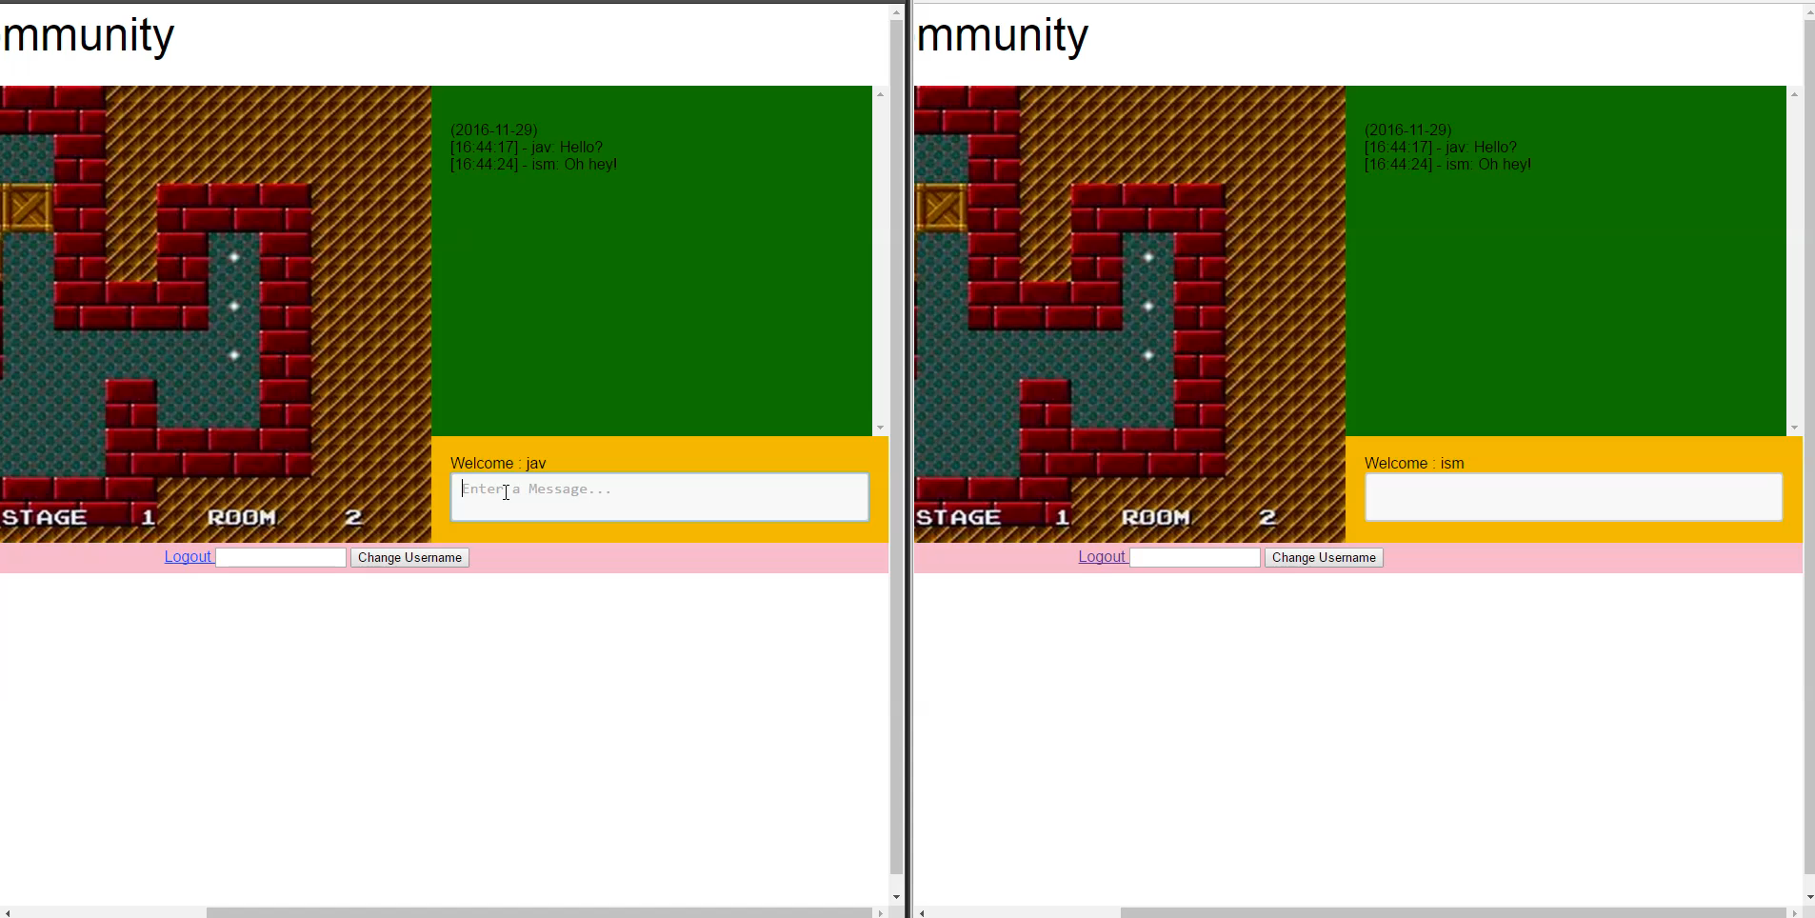
Behat Feature #3 – Demo Video

Slide 14
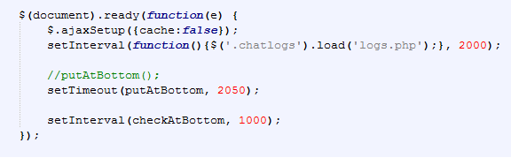
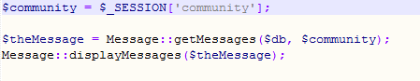
Behat Feature #3 – Scenario 1+2 Code
The ‘chatlogs’ class is refreshed every 2 seconds as it loads ‘logs.php’ which is a file that calls ‘getMessages()’, and will look like it is updated when a new message has been sent
MyChatEn.php
logs.php

Slide 15
Behat Feature #4
Feature #4: Chat History In order to view past messages As a User I need to be able to have historical messages stored and then displayed to me
Scenario: Messages are stored chronologically in the database to preserve a historically accurate order of events. Given that a message is stored in a database And a timestamp is added to the message When multiple messages are stored in the database Then they are kept in chronological order.
Scenario: Other users have previously sent messages to the web page and I can view them at a later time to keep up to date with the web page’s community. Given users have previously sent messages to the web page When I visit the web page Then the past messages that the other users have sent are displayed And I can catch up on what has been going on in the web page’s community.

Slide 16
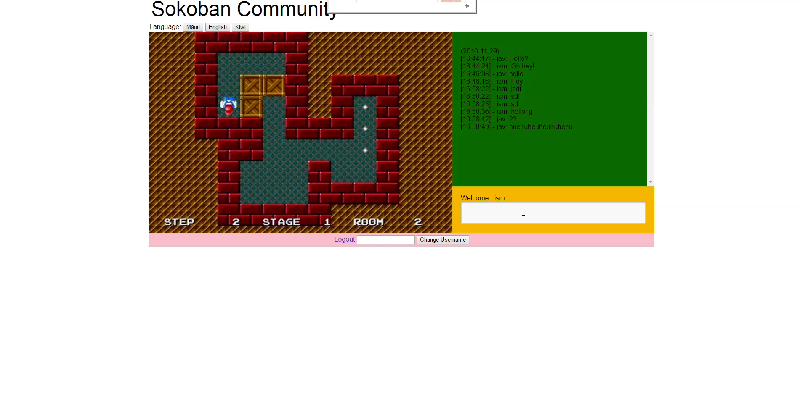
Behat Feature #4 – Demo Video

Slide 17
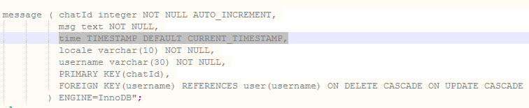
Behat Feature #4 – Scenario 1+2 Code
The messages are stored in the table with the ‘current_timestamp’ that the message was added at. This notifies the user when the message was sent. The ‘date’ is also displayed above all the messages that were sent on that day.
build.php
message.php

Slide 18
Configurable Communities
Sokoban and Maori

Slide 19
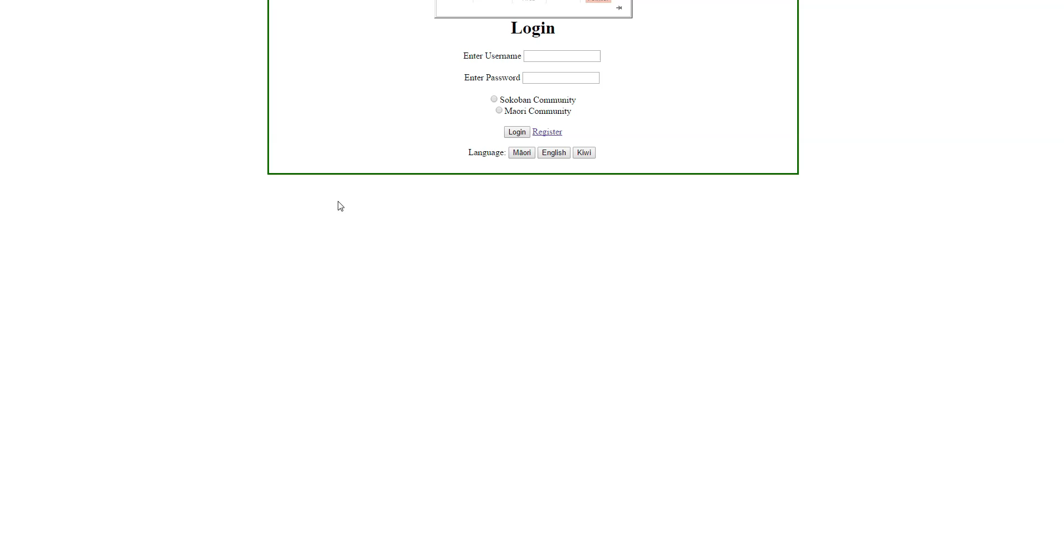
Sokoban Community VIDEO

Slide 20
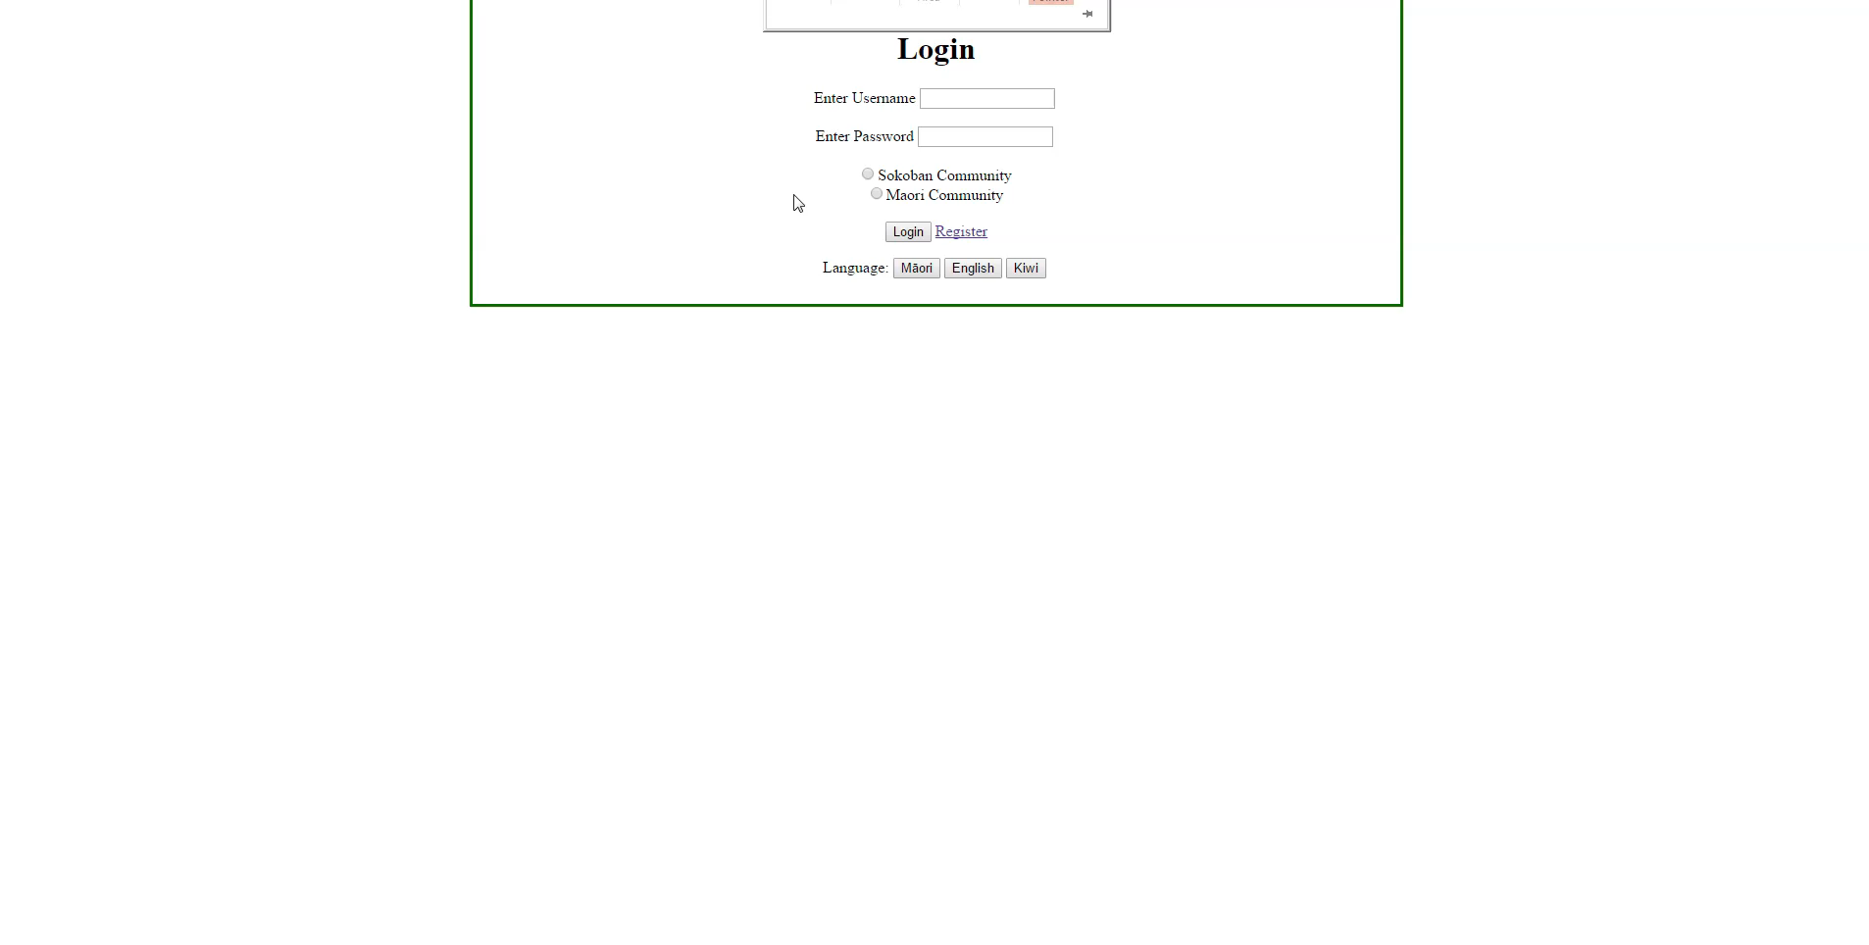
Maori Community VIDEO

Slide 21
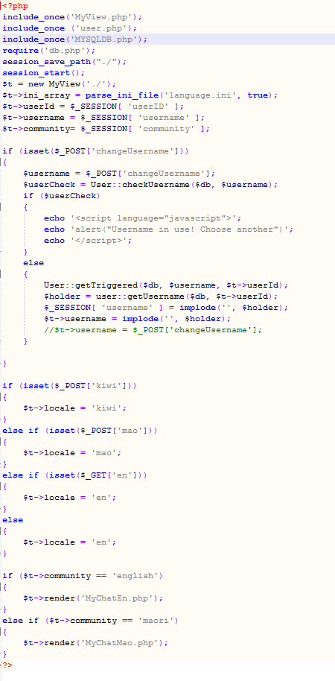
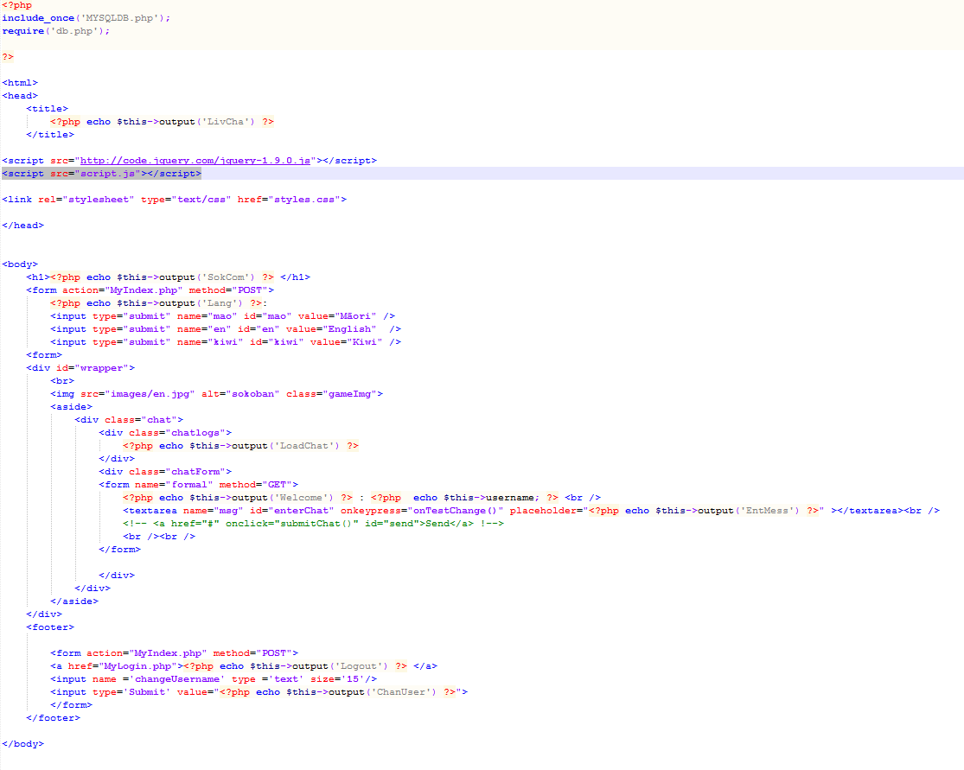
The Different Communities
Language
Communities
MyIndex.php
MyChatEn.php

Slide 22
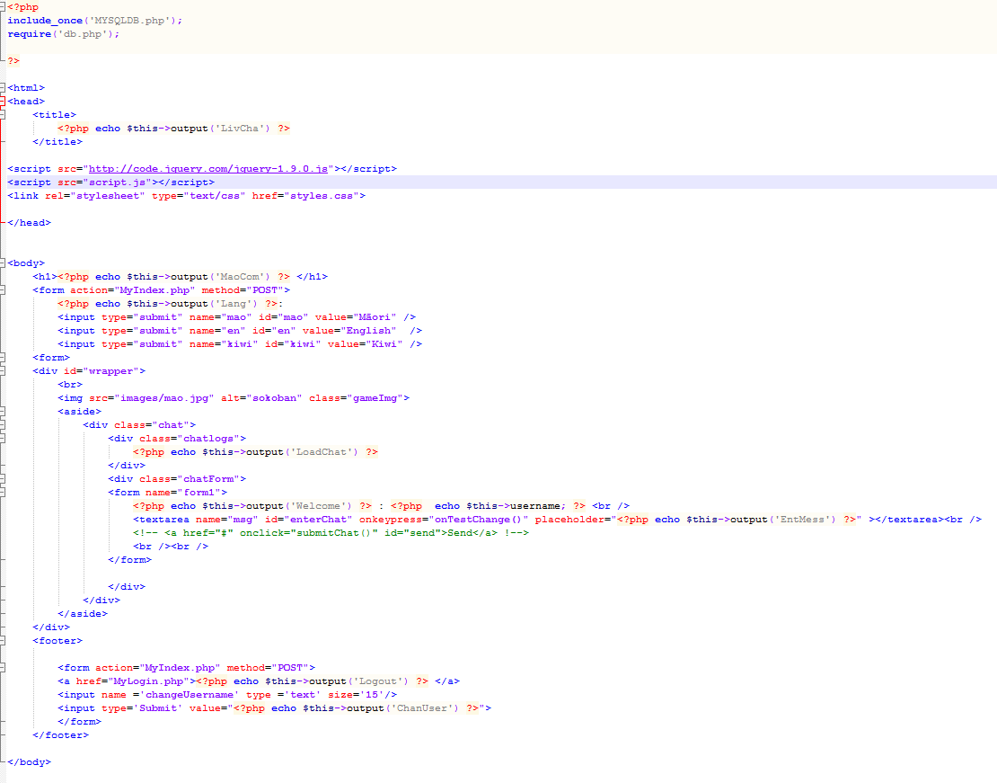
The Different Communities: Continued
The two communities are called depending on what radio button is checked when logging in or registering. This creates a community session that will then be checked to see which html page should be loaded for the community.
Both the communities use the same database but the chat is only accessible by the community that it was written in. This works by storing the community variable in the table with the message. When a message is retrieved, it is retrieved by the current community session.
This makes one database configurable for more than one community.
The language is changed through a ‘language.ini’ file.
MyChatMao.php

Slide 23
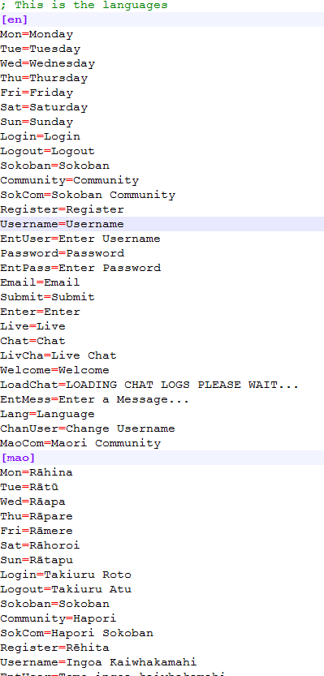
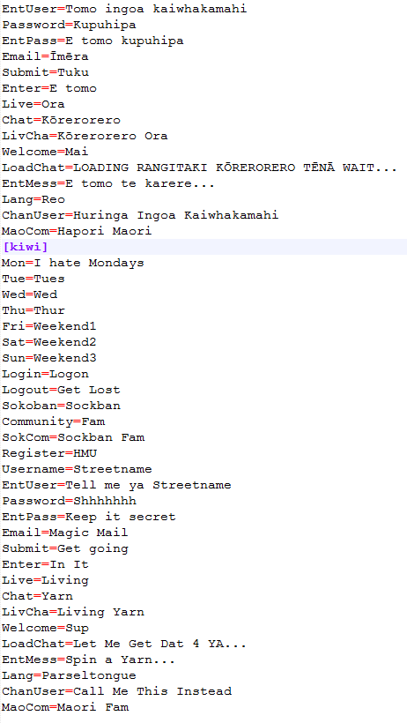
The Different Communities: Continued
This is the ini file that stores the language for the different languages of each community.
language.ini

Slide 24
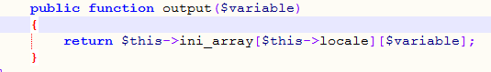
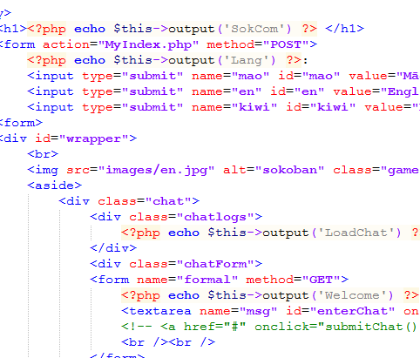
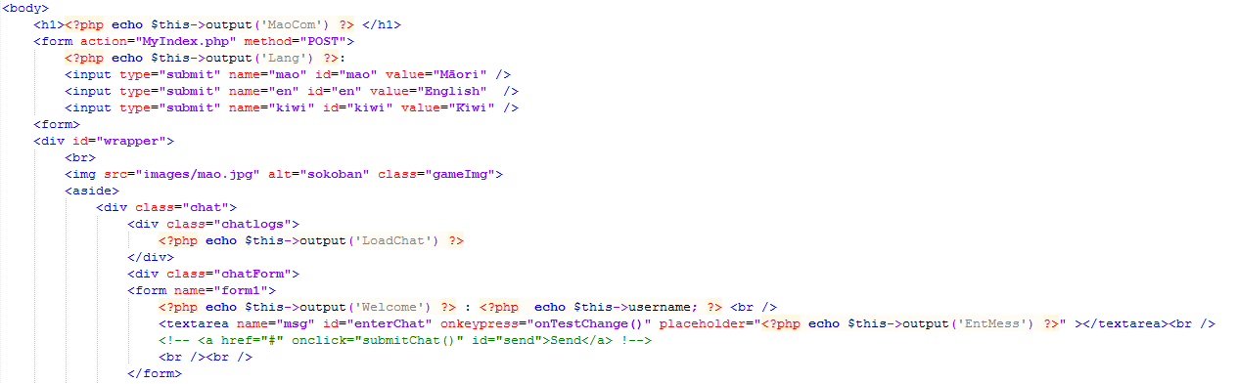
The Different Communities: Continued
MyIndex.php
‘MyIndex.php’ creates a variable that builds arrays based on what's inside the language.ini file. Then I have a function in ‘MyView.php’ that gets a position of the array based on the word and what language the session is currently.
This function is then called in ‘MyChatEn.php’ and ‘MyChatMao.php’ with the word that is wanted at that position. This word changes depending on the language.
MyView.php
MyChatEn.php
MyChatMao.php

Slide 25
Technical Features

Slide 26
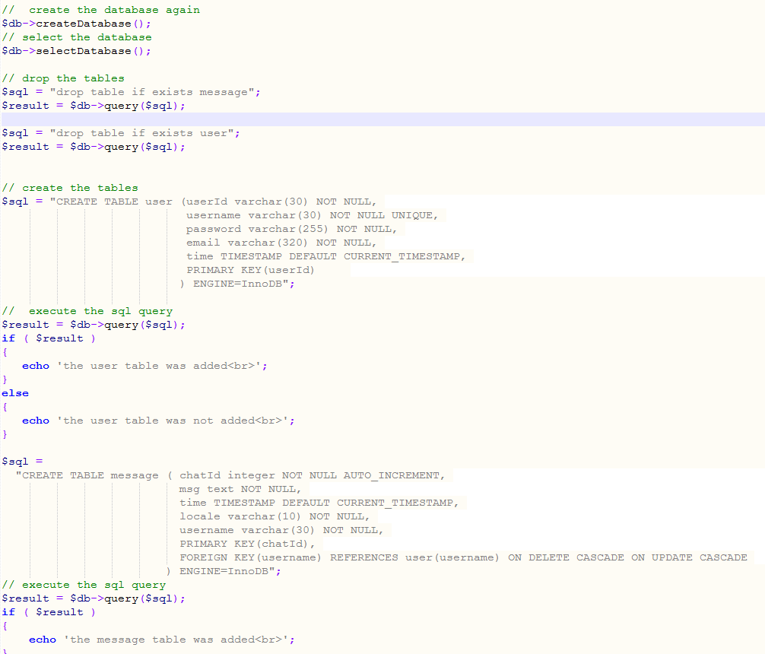
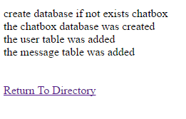
Makes a database of 2-3 tables
build.php
I have 2 tables that get created

Slide 27
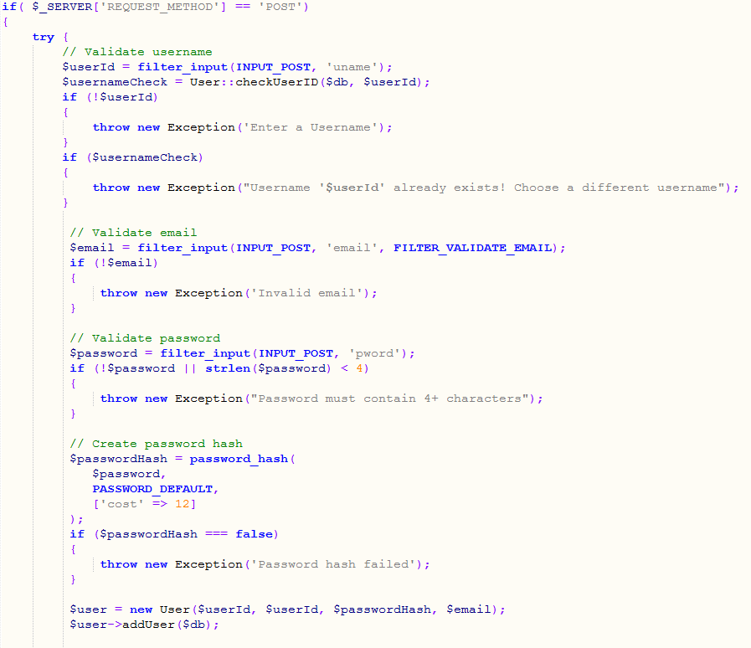
Gets data and inserts data
This is where the user data gets inputted to be inserted into the database
register.php

Slide 28
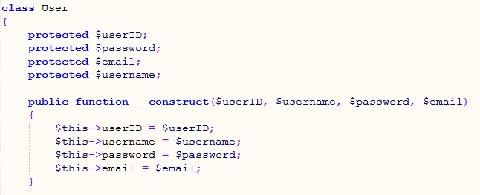
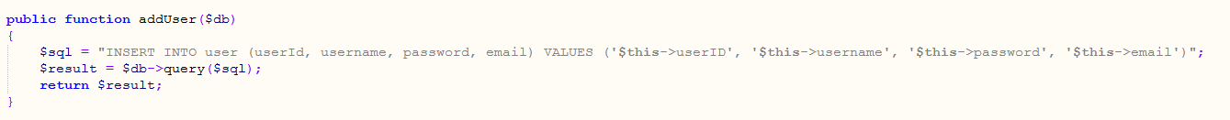
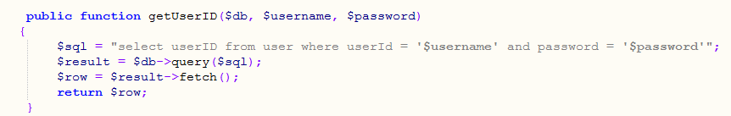
Gets data and inserts data: Continued
The user class contains get and insert functions as exampled in the pictures. This is so that a user can register and then be able to log in.
user.php

Slide 29
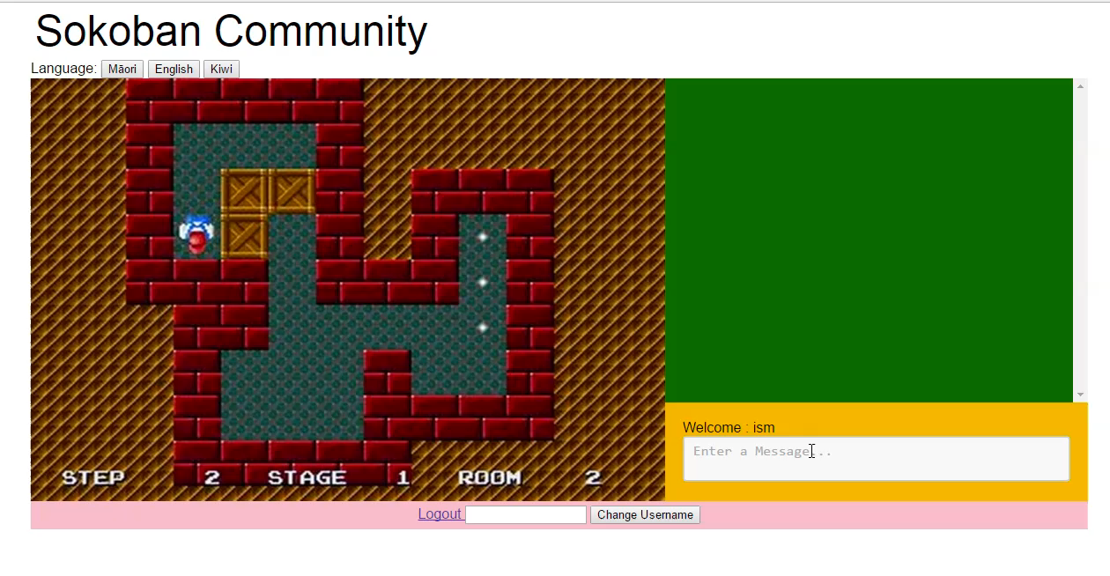
Modify existing data
user.php
This update query gets called when a user wants to change their ‘username(chatname)’.
VIDEO

Slide 30
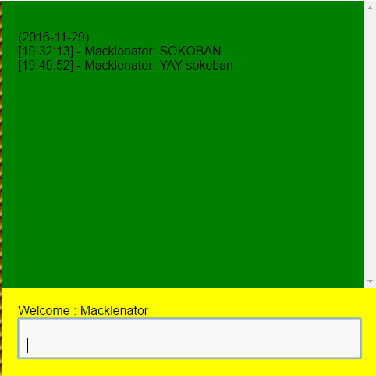
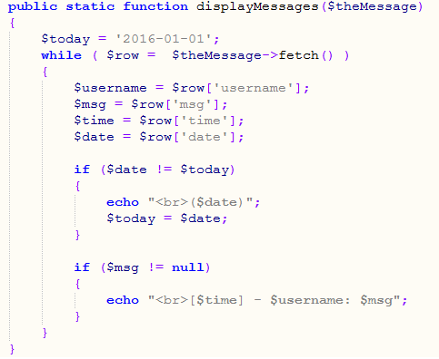
Simple select and display
message.php
This simple select query gets the messages from the database.
This function displays the message to the screen.
message.php
This is the messages displayed on the screen

Slide 31
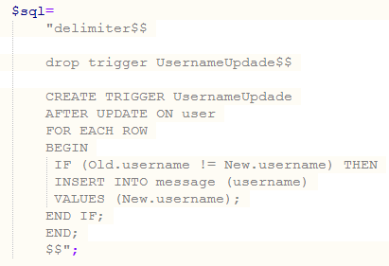
Complex subset query and display
This is a trigger that updates the ‘username’ field in the ‘message’ table, once the ‘username’ field has been updated in the ‘user’ table.
user.php

Slide 32
Secure

Slide 33
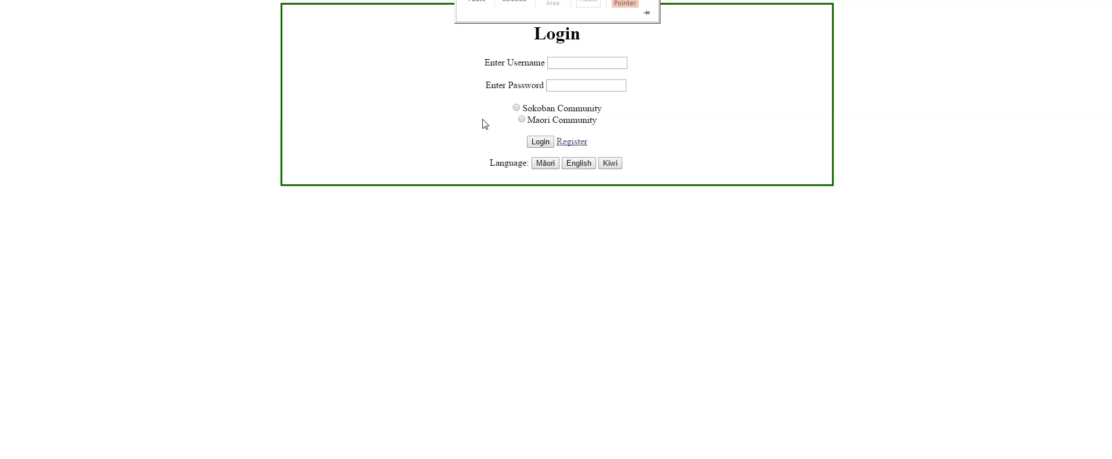
Secure Login - Video

Slide 34
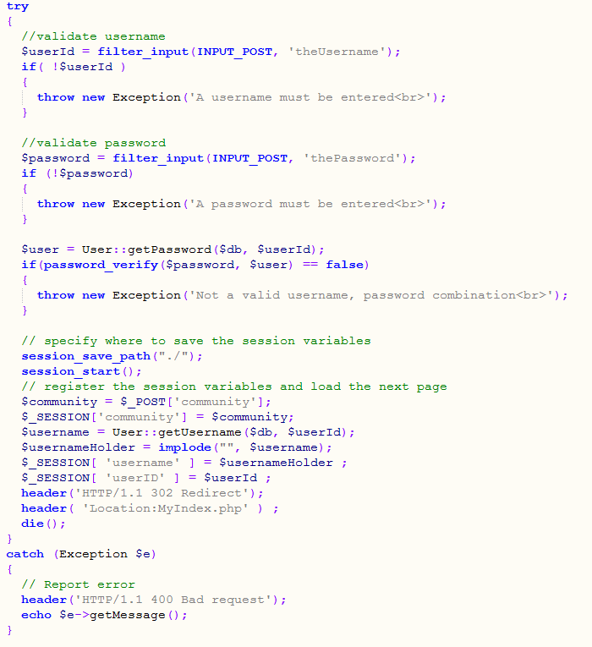
Secure Login - Code

Slide 35
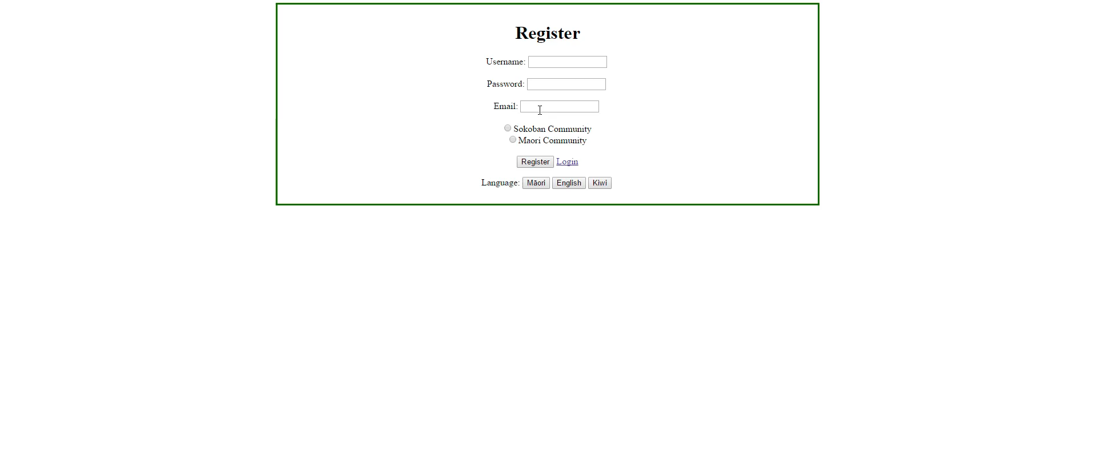
Secure Register - Video

Slide 36
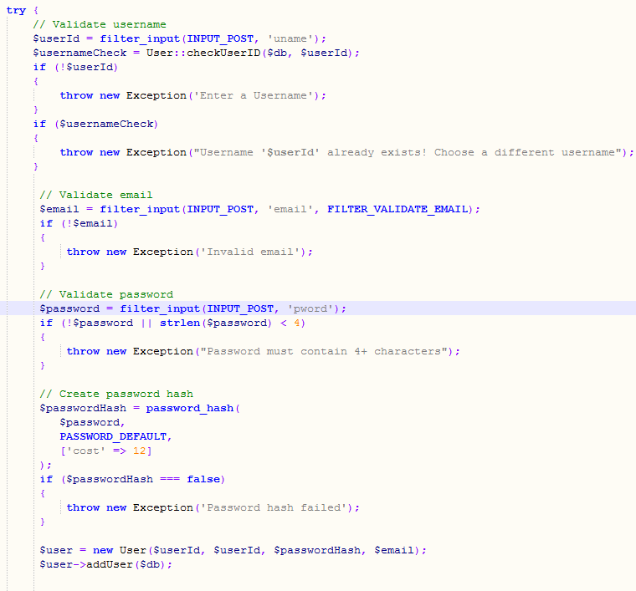
Secure Register - Code

Slide 37
Cross-site Scripting (XSS)
Explain the Attack
Cross-Site Scripting (XSS) attacks are a type of injection, in which malicious scripts are injected into otherwise benign and trusted web sites. XSS attacks occur when an attacker uses a web application to send malicious code, generally in the form of a browser side script, to a different end user. Flaws that allow these attacks to succeed are quite widespread and occur anywhere a web application uses input from a user within the output it generates without validating or encoding it.
https://www.owasp.org/index.php/Cross-site_Scripting_(XSS)
Often an XSS attack is a segment of JavaScript or HTML that is injected into an input box that doesn’t filter or validate inputs. The output will be the result of the inputted code.
For Example:
Inserting ‘<body onload=alert('test1')>’ in an input box would display a JavaScript alert box;

Slide 38
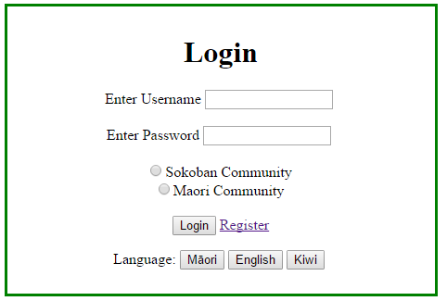
Cross-site Scripting (XSS)
Identify Where the Attack Could Be Used Against Your Site
This attack could be used on the input boxes of my login page

Slide 39
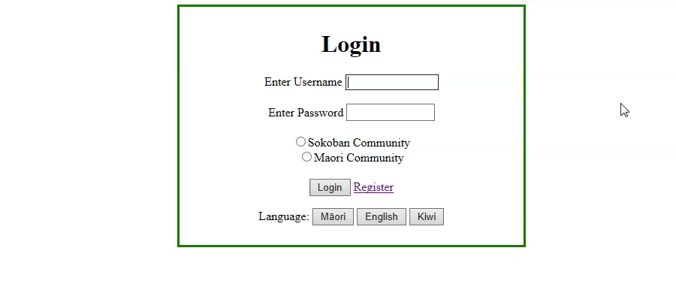
Cross-site Scripting (XSS)
Demo How the Attack Being Used Against An Unsecured Version of Your Site

Slide 40
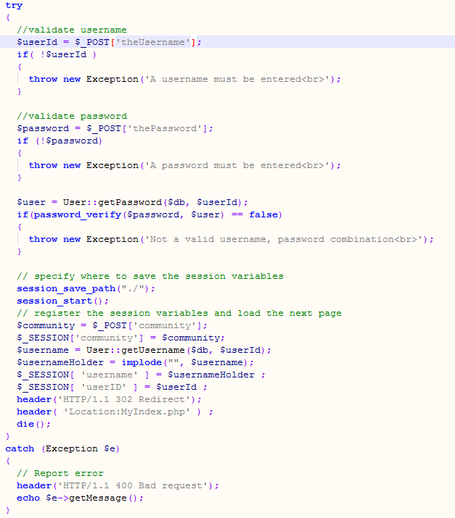
Cross-site Scripting (XSS)
Demo How the Attack Being Used Against An Unsecured Version of Your Site
Inputs aren’t filtered

Slide 41
Cross-site Scripting (XSS)
Display Code In Conforming To OWASP Guidelines That Protects Against the Attack
I didn’t use OWASP guideline code to project against this attack I used ‘Filter_Input’ from :
http://php.net/manual/en/function.filter-input.php
And use the filter ‘FILTER_SANITIZE_SPECIAL_CHARS’ to stop the XSS attack from working

Slide 42
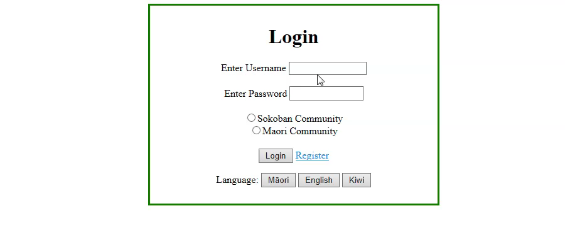
Cross-site Scripting (XSS)
Demo the Attack Failing Against a Secured Version Of Your Site

Slide 43
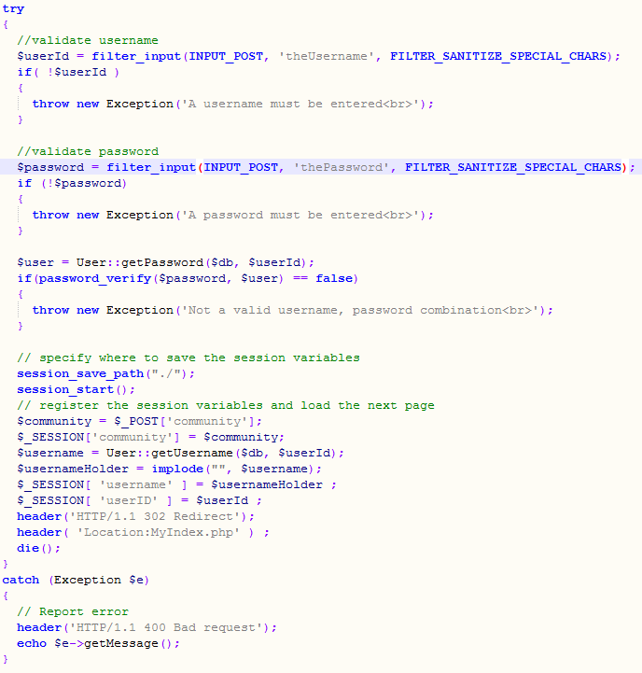
Cross-site Scripting (XSS)
Demo the Attack Failing Against a Secured Version Of Your Site
Inputs are filtered

Slide 44
SOLID

Slide 45
S – Single-Responsibility Principle
A class should have one and only one reason to change, meaning that a class should have only one job.

Slide 46
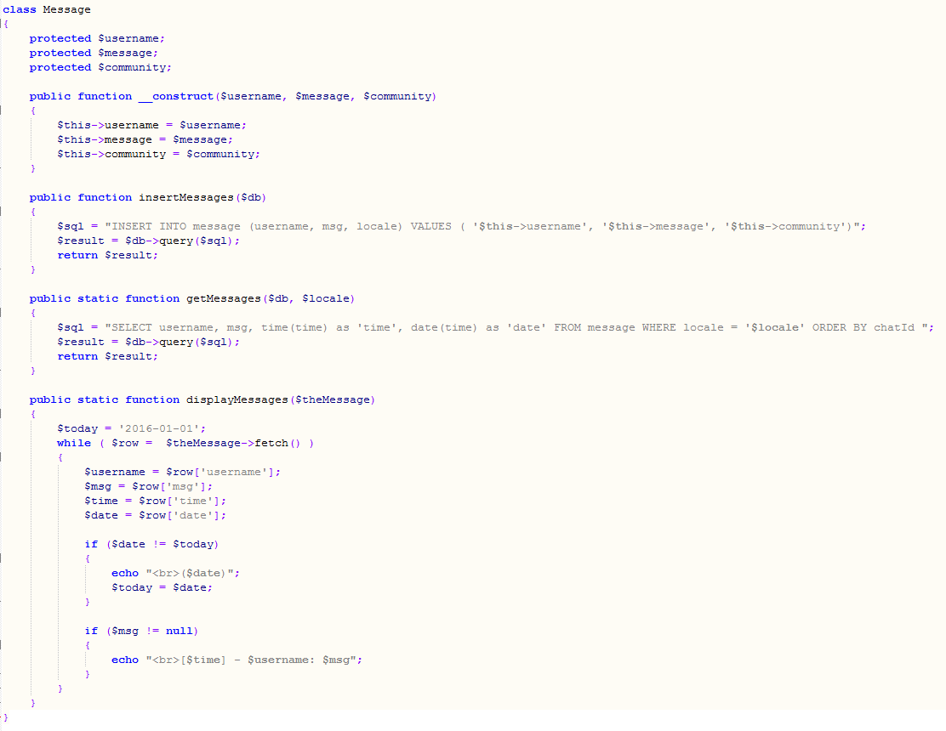
S – Single-Responsibility Principle
Code Example #1
The ‘message’ class has the single-responsibility of building MySQL queries relative to the ‘message’ table.

Slide 47
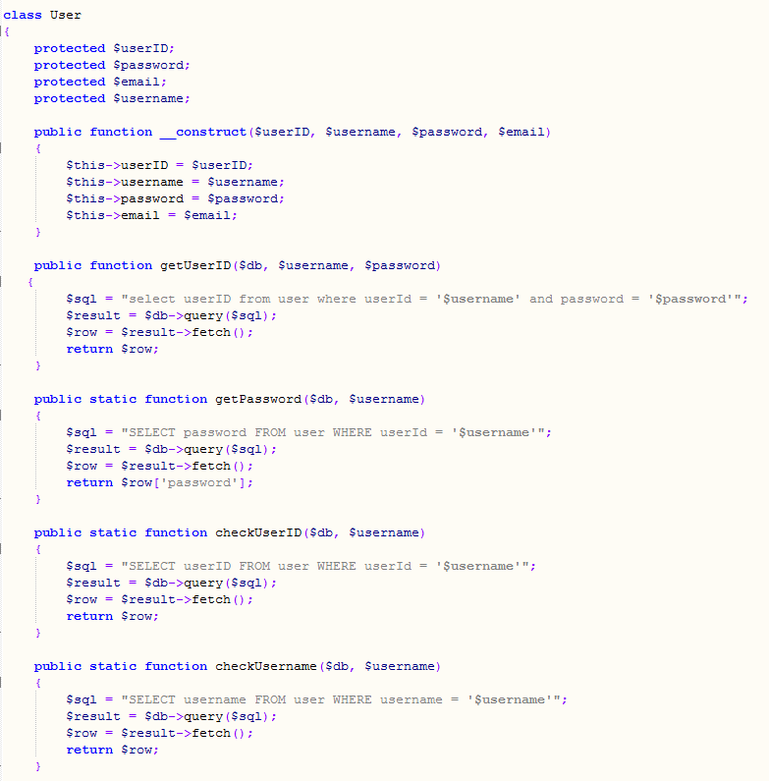
S – Single-Responsibility Principle
Code Example #2
The ‘user’ class has the single-responsibility of building MySQL queries relative to the ‘user’ table.

Slide 48
S – Single-Responsibility Principle
What I Should Do Next
The ‘user’ class and ‘message’ class both have a similar purpose of inserting, getting and displaying data from the database. These could be implemented with an interface that would contain an insert function, a get function and a display function.

Slide 49
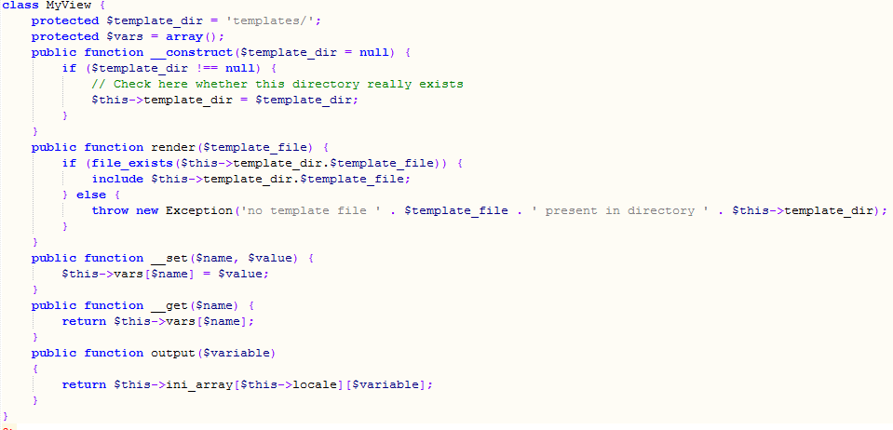
S – Single-Responsibility Principle
Code Example #3
The ‘MyView’ class has the single-responsibility of building the templates to display the HTML and PHP

Slide 50
O – Open-Closed Principle
Objects or entities should be open for extension, but closed for modification.
This simply means that a class should be easily extendable without modifying the class itself.

Slide 51
L – Liskov Substitution Principle
Let q(x) be a property provable about objects of x of type T. Then q(y) should be provable for objects y of type S where S is a subtype of T.
All this is stating is that every subclass/derived class should be substitutable for their base/parent class.

Slide 52
I – Interface Segregation Principle
A client should never be forced to implement an interface that it doesn’t use or clients shouldn’t be forced to depend on methods they do not use.

Slide 53
I – Interface Segregation Principle
What I Should Have Done Is
Created an interface for the ‘user’ and ‘message’ class that would contain an insert function, a get function and a display function. This is because both these classes implemented these functions

Slide 54
D – Dependency Inversion Principle
Entities must depend on abstractions not on concretions. It states that the high level module must not depend on the low level module, but they should depend on abstractions.

Slide 55
Lessons Learned

Slide 56
At the start of this course I had experienced PHP very briefly in high school but had no recollection of what I had actually learnt to use PHP for back then. I also had the pre knowledge of MySQL database which was helpful when it came to this final presentation. This is because I created a live chat that stores ‘messages’ and ‘users’ in a database that need to be inserted and retrieved.
The first introduction to PHP this semester was quite overwhelming, but as we slowly worked though small pieces a step at a time, all of a sudden it wasn’t that hard. It is helpful that it is implemented with HTML as I feel confident with writing HTML. Once I had got my head around how an ‘echo’ can work we stepped straight into ‘$_POST’. This had me so confused about how this actually worked, but it was kind of similar to ‘angular.js’ so it didn’t take me long to understand the concept. This left me with enough information to get a high mark in the first 3 weekly tests which I was stoked with. This was my first experience with PHP ‘applications’. The next learning curve was ‘classes’. These also had me very confused because of this new syntax: ‘$this->name = $name’ and ‘function __construct($name)’. Once I applied a class to a couple of PHP applications I was able to understand loosely how to use a class. This is because I learn best from doing. The next step was being able to implement a database with PHP to be able to insert and display data. Between this and starting the Final Presentation, was the learning of small pieces that became useful when actually creating the final project. Things such as Password encryption, templating, ini files, sessions and writing SOLID code. Writing SOLID code is still a work in progress as we didn’t cover a lot of this in class and it is quite a big thing to understand.
Apart from the learning about the different functions of PHP, most of my experience came from actually creating the PHP application for the Final Presentation. For example, I learnt that a try and catch is a lot easier to write than a nested if, classes are actually useful when you give them a purpose, and you can get carried away with features if you haven’t originally created a MoSCow list. I also have learnt a lot about secure logins and password encryption which I have quite enjoyed.
This course has really made me consider pursuing a career in PHP as it is one of my favourites that I have learnt so far. I have definitely learnt a lot more about the principles of coding. This has been from the experience of different programming languages and from a more willingness to learn as I am beginning to understand a lot more than when I started. I hope my interest in programming continues to grow.

